Slide 1

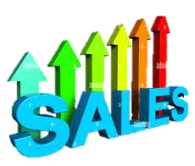
Car sales report analysis in mysql
NAME : NACHIMUTHU
MENTOR : KAVI BHARATHI
INSTITUTE : BESANT TECH
LOCATION : BTM LAYOUT-1

Slide 2
WHAT IS SQL?
1.MySQL stands for Structured Query Language
2.MySQL is a standard language for storing, manipulating and retrieving data in databases.
3.MySQL became a standard of the American National Standards Institute (ANSI) in 1986,
4. MySQL is an open-source relational database management system (RDBMS) that uses Structured Query Language (SQL) for database operations.

Slide 3
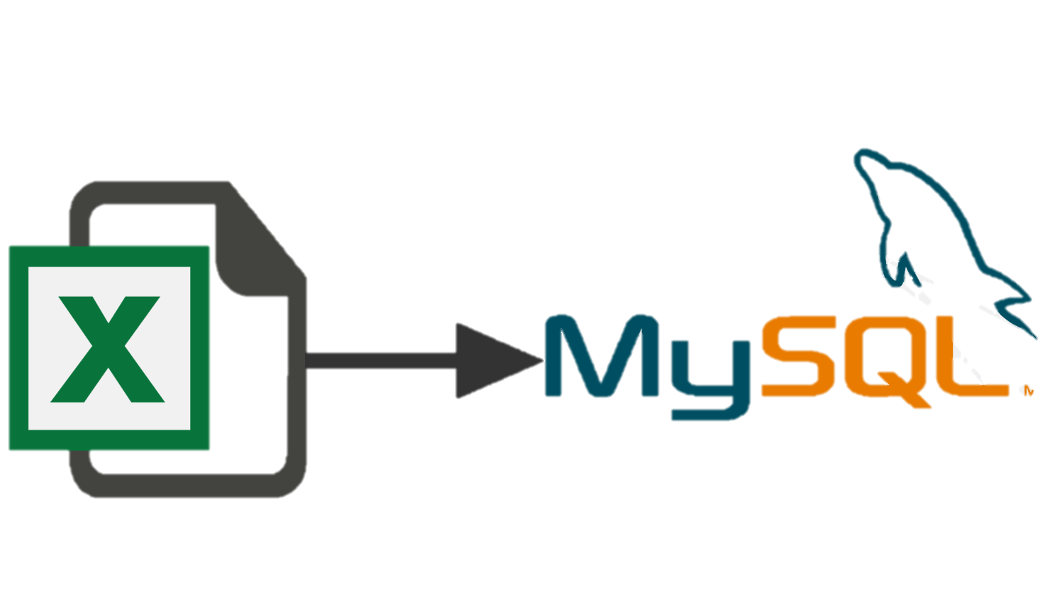
STEP BY STEP PRODUCER t0 EXPORTING DATA FROM EXCEL TO SQL
STEP-1 : Create a database .
create database car_sales;
STEP-2 : Refresh schema’s
STEP-3 : Right click on the Database select the Table Data Import Wizard
STEP-4 : New window opens and browse the Excel Document
STEP-5 : Select The File and Open it and Click Next.
STEP-6 : Select a Create New table and Click Next.
STEP-7 : Once again Click Next, Data Automatically Import to the Table
STEP-8 : Finally click Finish to Complete Import

Slide 4
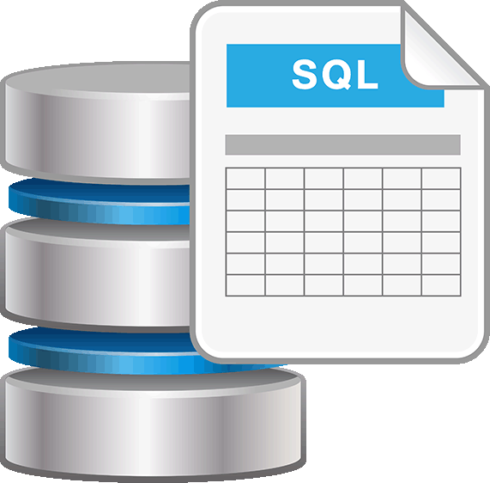
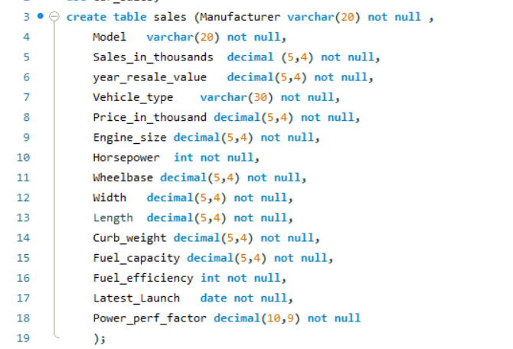
QUERIES TO CREATE TABLE

Slide 5

CLICK TO VIEW
CLICK THE IMAGE TO VIEW THE FULL SQL WORKBENCH

Slide 6

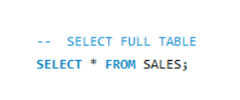
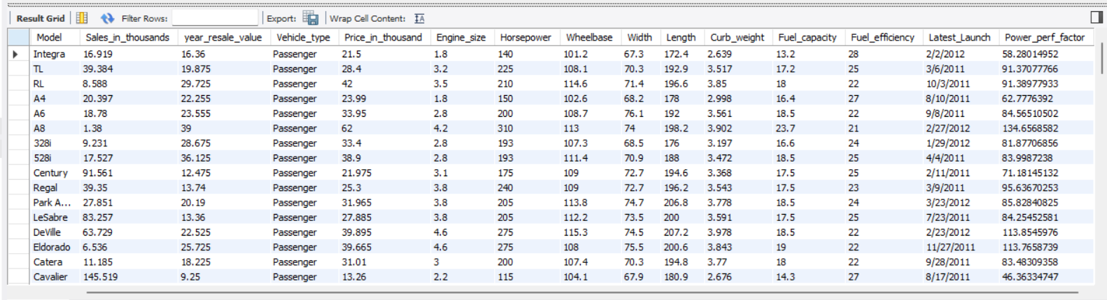
SHOW TABLE values from database

Slide 7
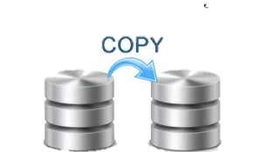
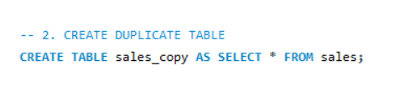
Create DUPLICATE TABLE FROM ORIGINAL TABLE

Slide 8
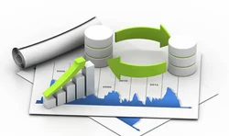
Summarizing and Analysing Sales Data Using SQL

Slide 9
Basic Queries: These retrieve counts, averages, and other statistics about the dataset.
Subqueries: These demonstrate more complex queries that depend on other queries.
Joins: These show how to combine data from the original and duplicate tables for deeper insights.
Advanced Queries: These perform aggregate functions and more complex data manipulations.

Slide 10
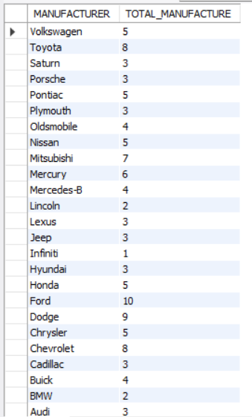
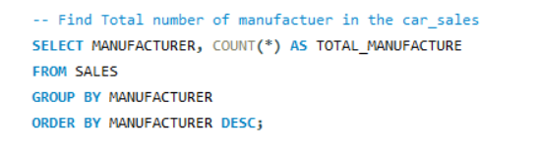
TOTAL NUMBER OF MANUFACTURERS
SQL Operation: Grouping data using GROUP BY and counting using COUNT.

Slide 11
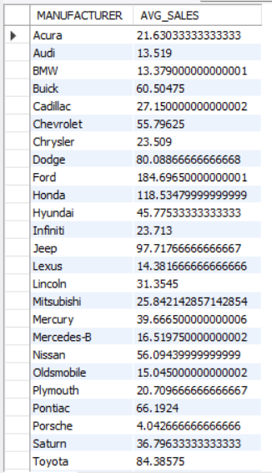

Average Vehicle Sales by Manufacturer
SQL Operation: Using AVG() to calculate
the mean sales

Slide 12
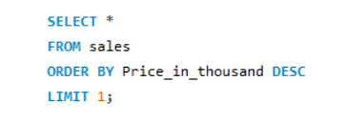
Vehicles with the Highest Price
SQL Operation: Using ORDER BY and LIMIT 1 to find the top result.

Slide 13
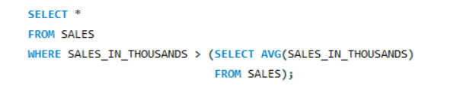
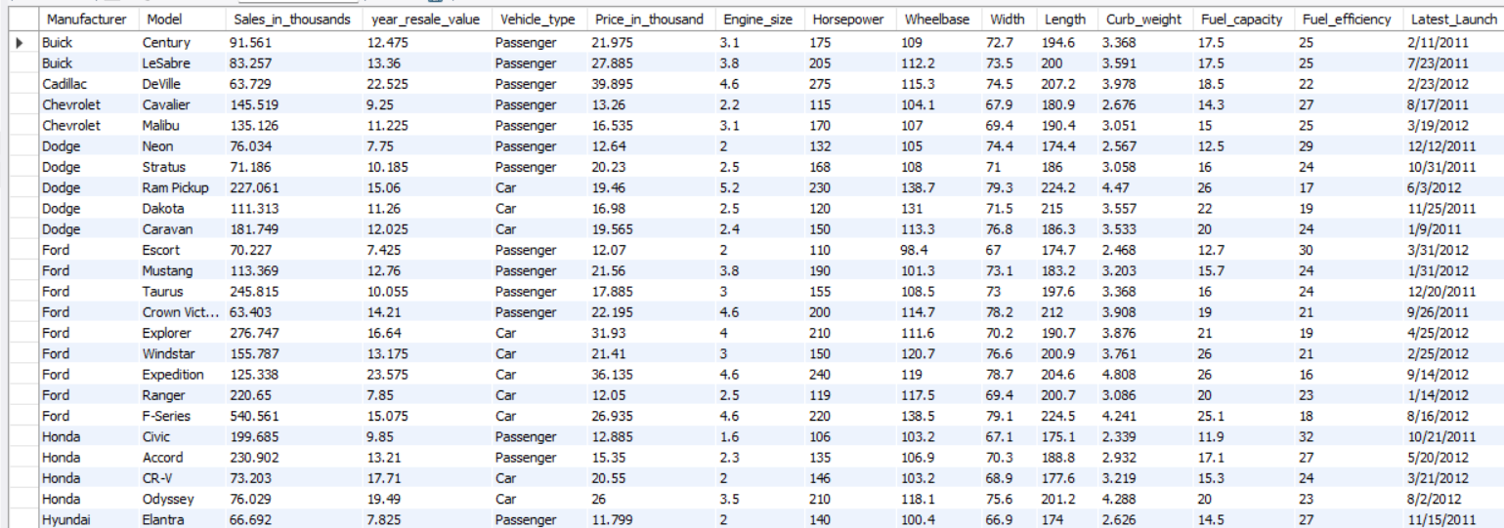
Vehicles with Prices Greater than the Average Price
SQL Operation: Sub-query to calculate the average and filtering using WHERE

Slide 14
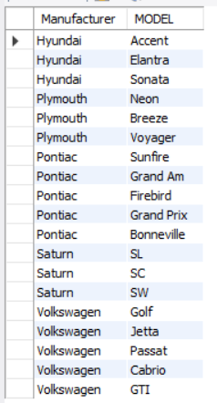
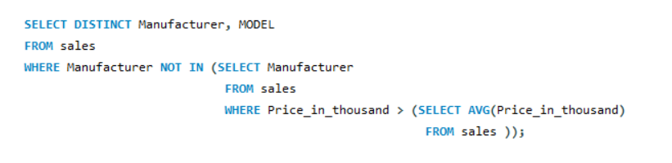
Manufacturers with Vehicles Below Average Price
SQL Operation: Sub-query to calculate the average and filtering using WHERE

Slide 15
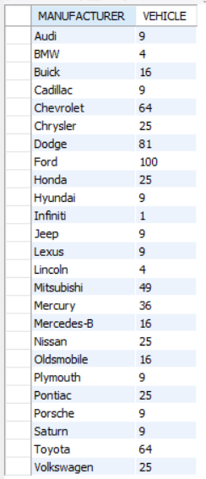
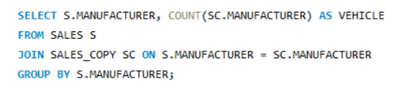
Join between “sales” and “sales_copy”
SQL Operation: JOIN to merge data and compare metrics
such as horsepower

Slide 16
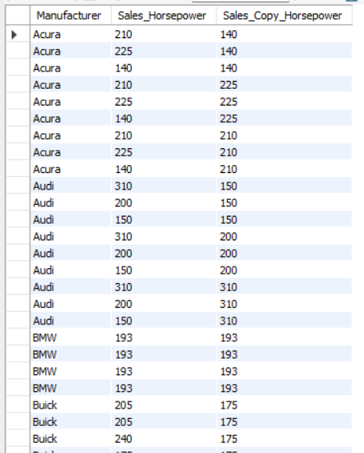
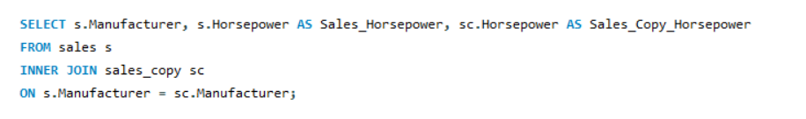
Compare Average Horsepower Between Original and Duplicate Tables
SQL Operation : JOIN with an aggregate function like AVG() Compare the average horsepower of manufacturers between the sales and sales_copy tables.

Slide 17
CONCLUSION
Comprehensive Data Analysis: The project successfully analyzed car sales data, providing insights into manufacturer performance, vehicle types, and pricing trends. Through various SQL queries, key metrics such as average prices and sales counts were effectively calculated.
Utilization of Joins: Advanced SQL techniques, including different types of joins (INNER, LEFT, RIGHT), were employed to merge data from the original and duplicate tables, facilitating in-depth comparisons and enriched analysis.
Data Integrity and Duplication: Creating a duplicate table allowed for validation and comparison of results, ensuring data integrity while performing complex queries. This approach enhanced understanding of data relationships and potential discrepancies.

